Slide 1


Nomado
SECURE IDENTITY FOR THE MODERN TRAVELER
Offline, encrypted, and under your full control.

Slide 2



Nomado
The problem
Every trip, we juggle passports, visas, insurance, and medical papers — and we constantly worry:
‘What if I lose them? What if someone misuses my data?’
Travelers carry sensitive documents everywhere.
Loss = chaos, exposure, and identity risk.
Existing “digital wallets” rely on cloud storage and are not private.

Slide 3



Nomado
Our Initial Idea
At first, we wanted to solve it by digitalizing passports, but...
Government-issued IDs are legally protected.
Private systems cannot replace or replicate them.
Changing regulations would take years.

Slide 4


Nomado
The Pivot: From Bureaucracy to Privacy
If not passports, what else causes the same pain — loss, exposure, stress?
01
Insurance:
02
Medical documents:
travelers lose policies or don’t know if they’re valid.
private, messy, and often needed abroa
03
Visas & permits:
Protect and simplify travel documentation without changing any law.
scattered and hard to verify.

Slide 5
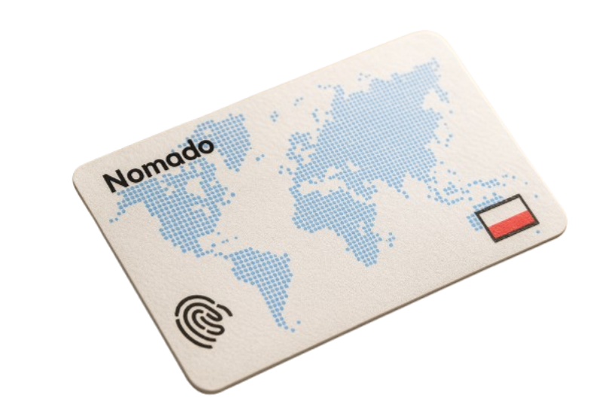
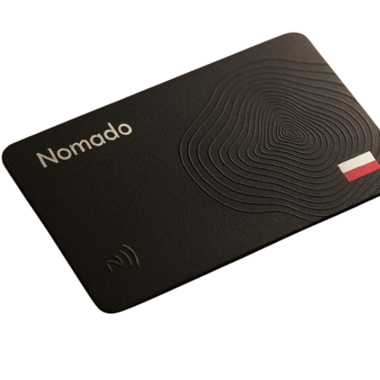

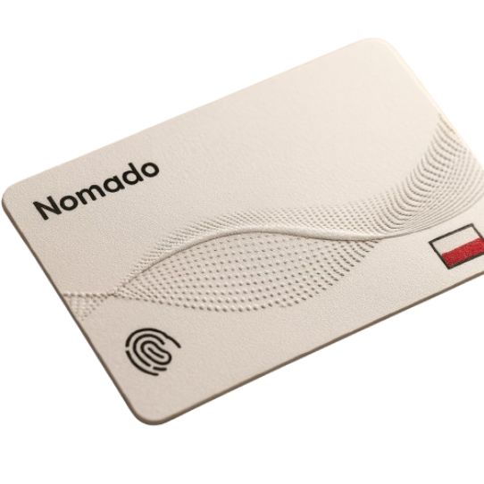
Nomado
The solution
Nomado Card + Kiosk
How it works?
Data encrypted locally at a Nomado Kiosk — no cloud, no servers.
Fingerprint-based cryptographic key (no biometric stored).
If lost → card is unreadable.
Offline by design. Private by principle.

Slide 6
Nomado
Our business model
Key Partners
Key Activities
Value Propositions
Customer Relationship
Customer Segments
Design, manufacturing, and maintenance of Nomado kiosks and health identity cards
Development of secure encryption and access protocols for health data
Hospitals, clinics, and diagnostic centers
Health insurance providers
Hardware manufacturing partners (Nomado Kiosk and Health Card production)
Medical data authorities and certification bodies (validation of health data)
Nomado protects patients from those who could misuse their health data — and empowers hospitals, the ones we trust, to use it responsibly.
Long-term institutional partnerships with hospitals and insurers
Maintenance, updates, and certification renewals for compliance
Hospitals
travellers
health insurance providers
Key Resources
Channel
Hardware platform (Nomado Kiosk, Nomado Card)
Encryption software
Partnerships with medical and insurance organizations
B2B sales to hospitals and insurance networks
Cost Structure
Revenue Stream
Hardware production (kiosks, cards, terminals)
Compliance certification and legal advisory costs
Software development and security infrastructure
Service fees for Nomado Card issuance (through insurers or clinics)
Annual subscription for compliance maintenance and system updates

Slide 7


Nomado
Vision
We want to be the physical bridge between today’s travel and tomorrow’s digital identity:
Nomado is the trusted hardware layer between people and the systems they must interact with —
A decentralized, human-centered approach to privacy.

Slide 8

Nomado
Our mission
Our mission is simple: make travel safer, calmer, and truly private:
If you lose the card — it’s just plastic.
But when you use it — it’s your world, protected

Slide 9
Thank You

